Slide 1

DEPARTMENT OF ARTIFICIAL INTELLIGENCE AND DATA SCIENCE ACADEMIC YEAR 2025 - 2026 SEMESTER III ARTIFICIAL INTELLIGENCE LABORATORY MINI PROJECT REVIEW SUDUKO SOLVER USING CSP ALGORITHM
REGISTER NUMBER | 2117240070009
NAME | AGILA K
YEAR | II
SECTION | A
FACULTY IN-CHARGE | Mrs. M. Divya

Slide 2
PROBLEM STATEMENT
Design and implement a Sudoku solver that:
Models Sudoku as a Constraint Satisfaction Problem (CSP).
Uses inference (AC-3 / forward checking) and search (backtracking) to solve puzzles.
Incorporates heuristics (MRV, degree heuristic) to improve performance.
Accepts a puzzle in a simple textual format and outputs the solved grid.
Goals:
Demonstrate CSP modeling for Sudoku.
Implement constraint propagation and backtracking search with heuristics.
Produce a solver that reliably solves common and difficult Sudoku puzzles.
Explain algorithmic choices and provide sample outputs.

Slide 3
THEORETICAL BACKGROUND
A CSP is defined by a set of variables, each with a domain of possible values, and a set of constraints that restrict the values that subsets of variables may simultaneously take. A solution assigns a value to every variable so that all constraints are satisfied.
For Sudoku:
Variables: Each cell (row, col) in the 9×9 grid, usually indexed as R1C1..R9C9.
Domains: For an unfilled cell, {1,2,...,9}; for a filled cell, the singleton containing the given value.
Constraints: All cells sharing a row, column, or 3×3 box must have different values.
Inference and Heuristics
AC-3 (Arc Consistency): Repeatedly revise domains of variables so that for every value of a variable there exists a consistent value in each neighboring variable. AC-3 is effective at reducing domains before (and during) search.
Forward Checking: After assigning a value to a variable, eliminate that value from domains of neighboring unassigned variables; if any domain becomes empty, backtrack.
Minimum Remaining Values (MRV): Select the unassigned variable with the smallest remaining domain (most constrained) to branch on first.
Degree Heuristic: Break MRV ties by choosing the variable with the largest number of unassigned neighbors.
Combining these methods produces a highly effective Sudoku solver.

Slide 4
IMPLEMENTATION AND CODE
Link to code in Git-hub Repository
List | Git-hub Repository Links
Implementation of Code Link | https://github.com/agila1010-creator/suduko-game
Word Document Report Link | https://github.com/agila1010-creator/suduko-game/blob/main/suduko%20-Agila.docx
PPT Link | https://github.com/agila1010-creator/suduko-game/blob/main/agila%20ai%20mini%20project.pptx

Slide 5
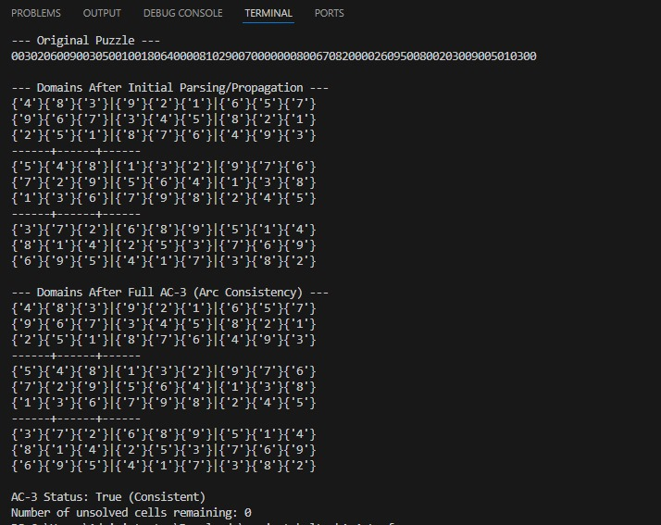
OUTPUT AND RESULTS

Slide 6
OUTPUT AND RESULTS
Results:
The CSP-based solver reliably solves typical and many hard Sudoku instances.
Heuristics and AC-3 significantly reduce the search space compared to naive brute force.
Future enhancements:
Implement more advanced techniques used by human solvers (naked pairs, X-Wing, swordfish).
Add least-constraining-value ordering to improve branching.
Create a GUI (Tkinter / web) for interactive play and puzzle input.
Parallelize search or add optimized C-based core for speed.

Slide 7
REFERENCES
Russell, S. J., & Norvig, P. (2021). Artificial Intelligence: A Modern Approach.
Peter Norvig. "Solving Every Sudoku Puzzle" (essay and implementation). 2006.
CSP literature: AC-3 algorithm, MRV heuristic, forward checking.
Example implementations and python resources on Sudoku solving.

